Slide 1
CLOUD DEVOPS PROJECT
TITLE:
Title: To perform continuous testing and continuous deployment using Jenkins, dockers and selenium
Tools: Git, Jenkins, Docker, Selenium
TEAM MEMBERS:
2200030203 - vignesh
2200032433 - prudvi raj
2200032535 - yaswanth
2200080173-Sravya

Slide 2
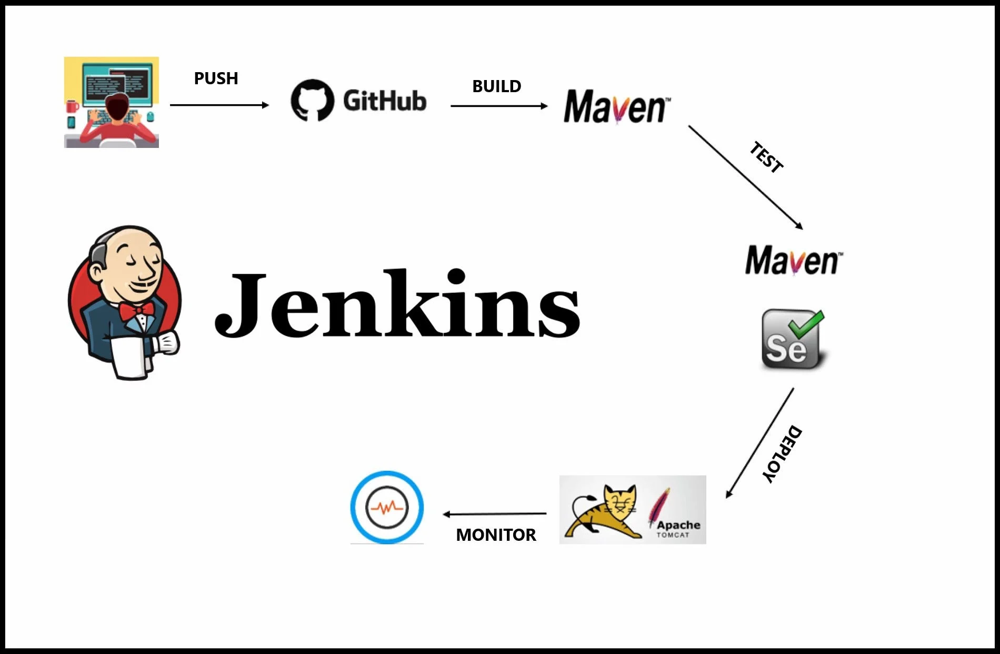
Continuous Testing and Deployment with Jenkins, Docker, and Selenium
This presentation outlines a comprehensive approach to continuous testing and continuous deployment (CI/CD) using a powerful combination of tools: Git, Jenkins, Docker, and Selenium. We'll explore how these technologies can be integrated to automate the software release pipeline, ensuring faster delivery, improved quality, and reduced risk.

Slide 3

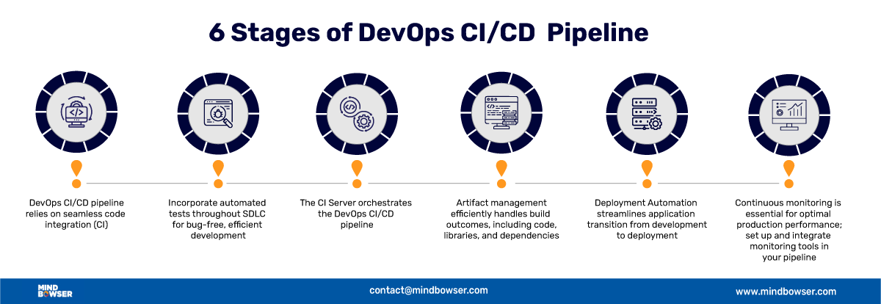
Overview of the CI/CD Pipeline
Code Commit (Git)
1
Developers commit code changes to a Git repository, triggering the CI/CD pipeline.
Build & Test (Jenkins, Selenium)
Jenkins automates building the application and executing Selenium-based tests.
2
Containerization (Docker)
Docker packages the application and its dependencies into a portable container.
3
Deployment (Jenkins)
Jenkins deploys the Docker container to the target environment (e.g., staging, production).
4

Slide 4
Git: The Foundation of Version Control
Source Code Management
Git is a distributed version control system that tracks changes to source code, enabling collaboration and preventing conflicts.
Branching and Merging
Git's branching model allows developers to work on features independently and merge them seamlessly.
Collaboration
Git facilitates collaborative development through pull requests and code reviews.

Slide 5
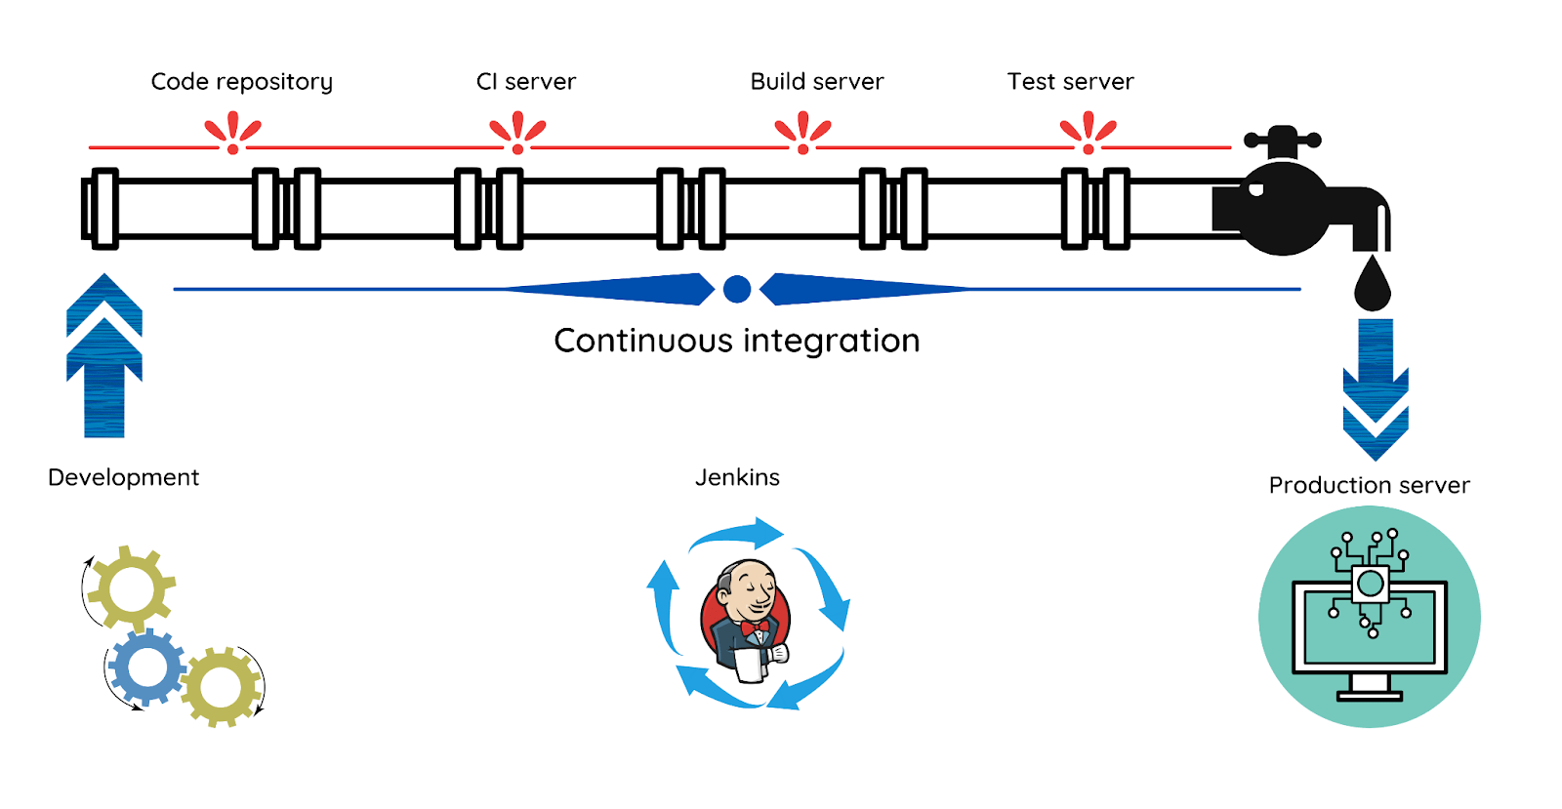
Jenkins: The Automation Server
Continuous Integration
Jenkins automates the build, test, and integration of code changes, providing rapid feedback to developers.
Continuous Delivery
Jenkins automates the release process, enabling frequent and reliable software deployments.
Extensibility
Jenkins has a rich ecosystem of plugins that integrate with various tools and technologies.

Slide 6

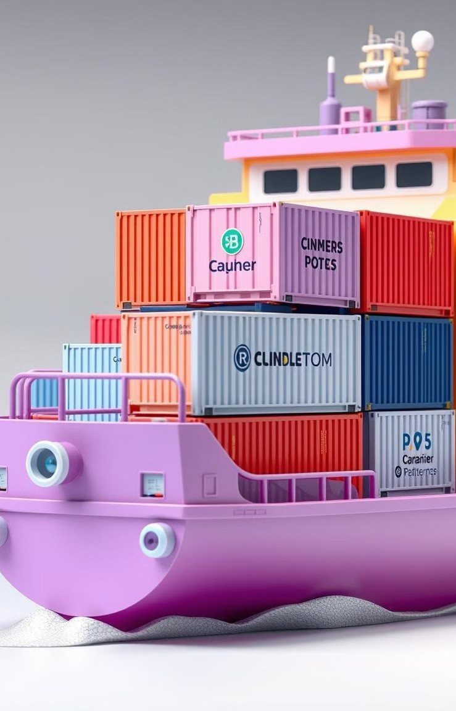
Docker: Containerization for Consistency
1
Isolation
Docker containers provide isolation, ensuring that applications run consistently across different environments.
2
Portability
Docker containers are portable, making it easy to deploy applications to various platforms.
3
Scalability
Docker containers can be easily scaled to meet changing demands.

Slide 7
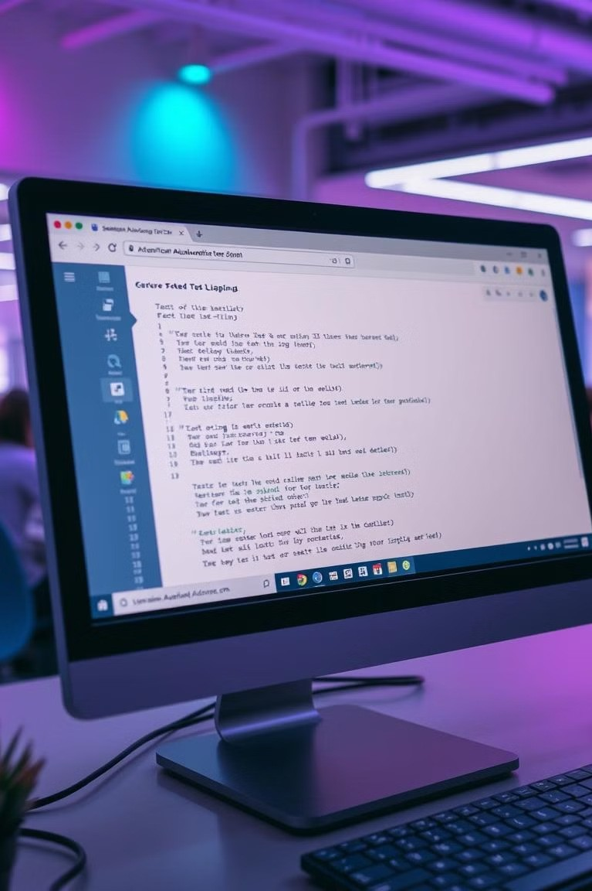
Selenium: Automated Testing
Automated Testing
Selenium automates web browser interactions, enabling comprehensive testing of web applications.
Cross-Browser Compatibility
Selenium supports multiple browsers, ensuring cross- browser compatibility.
Test Reporting
Selenium generates detailed test reports, providing insights into application quality.

Slide 8
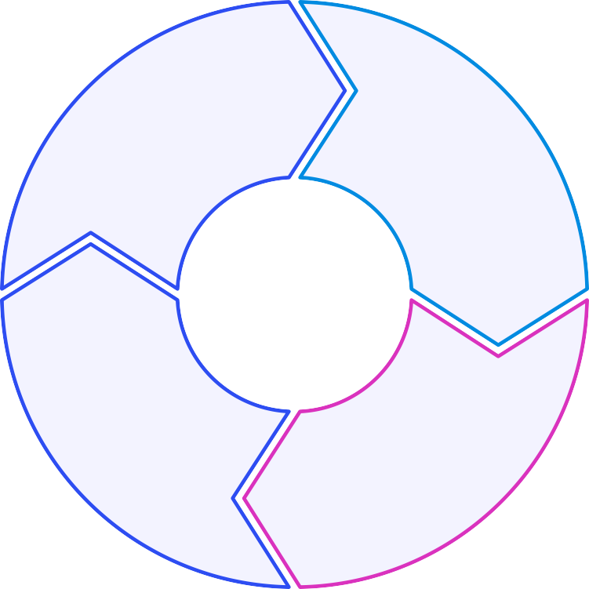
Integrating the Tools for a Seamless Workflow
Jenkins Build
Git Trigger
Code commit triggers Jenkins build.
1
Jenkins builds the application and runs Selenium tests.
2
Deploy
Jenkins deploys the Docker image to
the target environment.
4
Dockerize
Jenkins creates a Docker image.
3

Slide 9
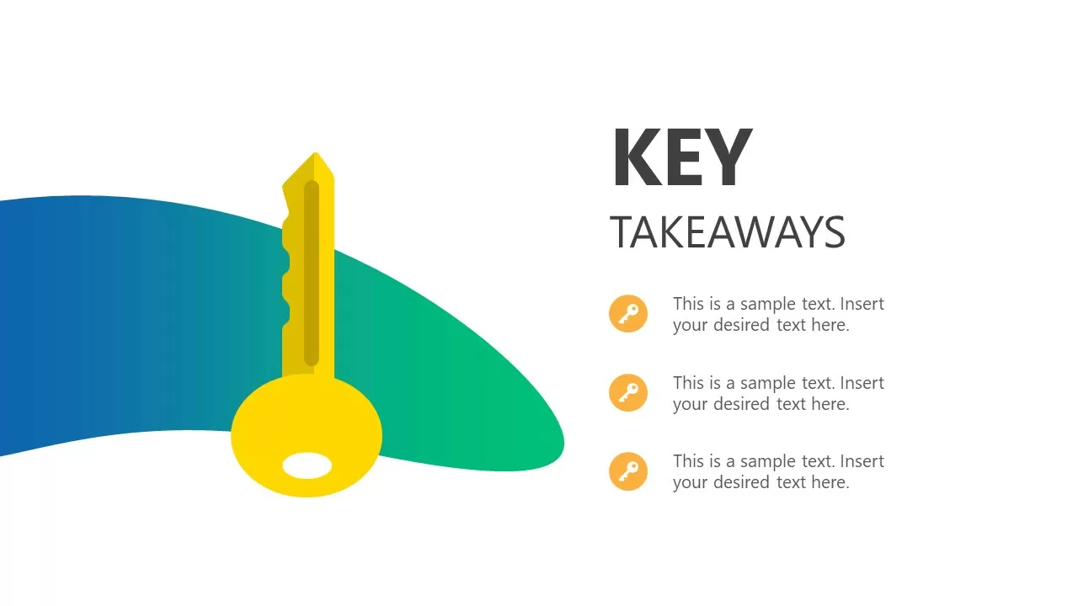
Key Takeaways and Next Steps
By integrating Git, Jenkins, Docker, and Selenium, organizations can achieve a fully automated CI/CD pipeline, resulting in faster releases, improved quality, and reduced risk. As a next step, consider implementing a pilot CI/CD pipeline for a small project to gain experience and refine your approach. Begin by setting up Jenkins and Docker, then integrating Selenium tests into your Jenkins pipeline. Continuously monitor and optimize your pipeline for maximum efficiency and effectiveness.

Slide 10


